Slide 1


InstaMesh Graph Theory Case Study
David Mayo, Software Engineer

Slide 2

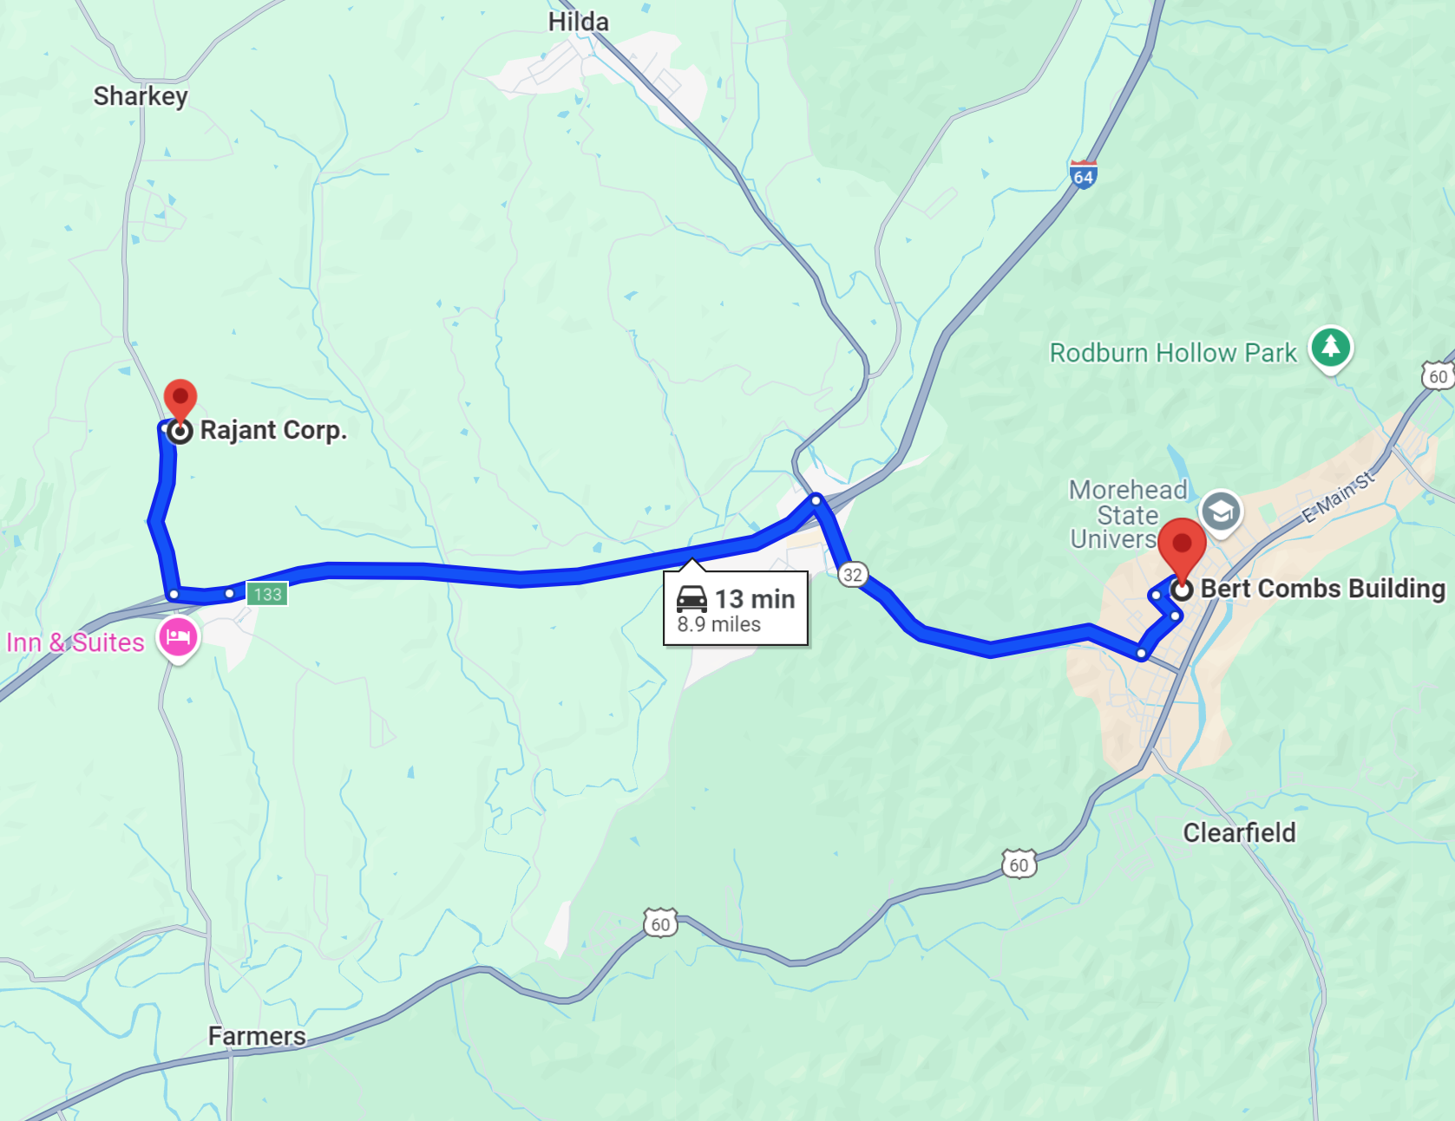


Company Brief
Pioneer of Kinetic Mesh® wireless BreadCrumb® wireless devices, the industry standard for reliable industrial mesh networking in the most challenging RF environments, using proprietary, patented InstaMesh® algorithm.
Based in the U.S., Rajant has successful deployments in over 80 countries Almost all our manufacturing—and a lot of our engineering—is done in Morehead, Kentucky.
Powered by Morehead State University Graduates ~30 MSU graduates on staff ~15 MSU engineering graduates on staff ~5 MSU computer science alumni on staff (including me!)
2

Slide 3
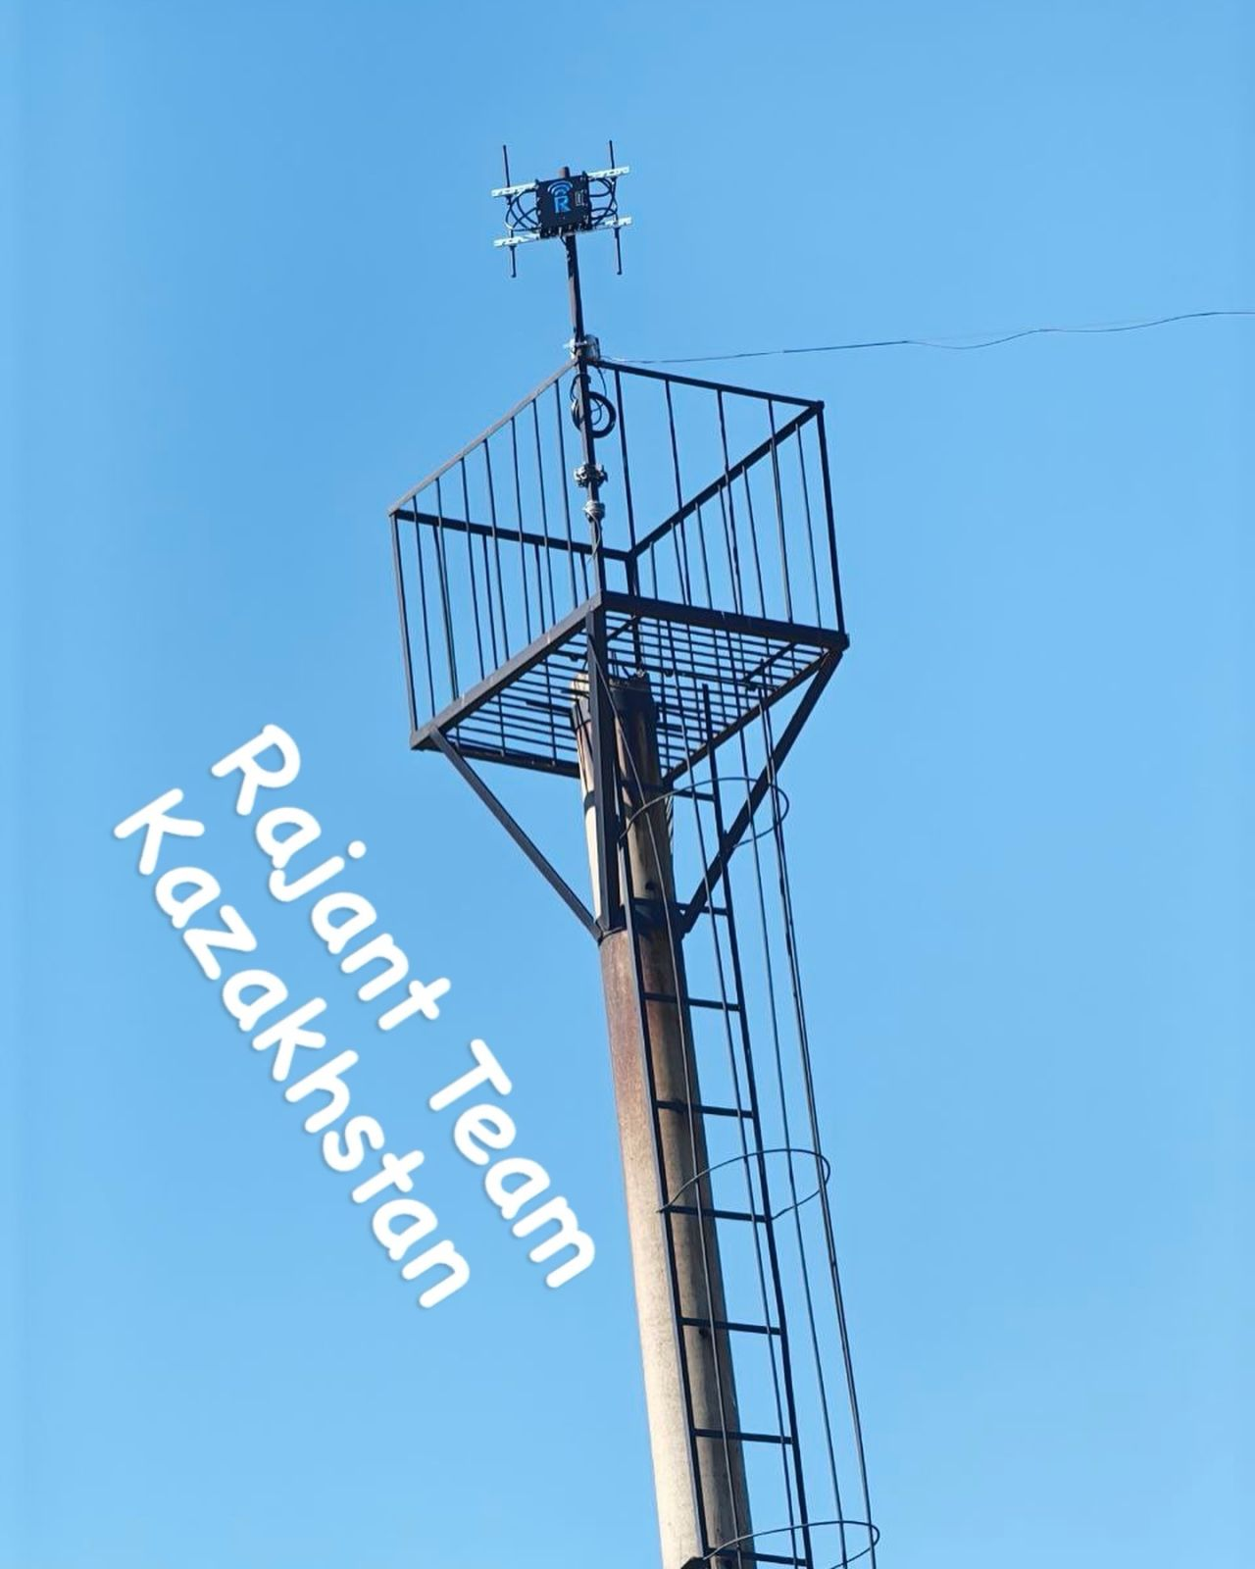
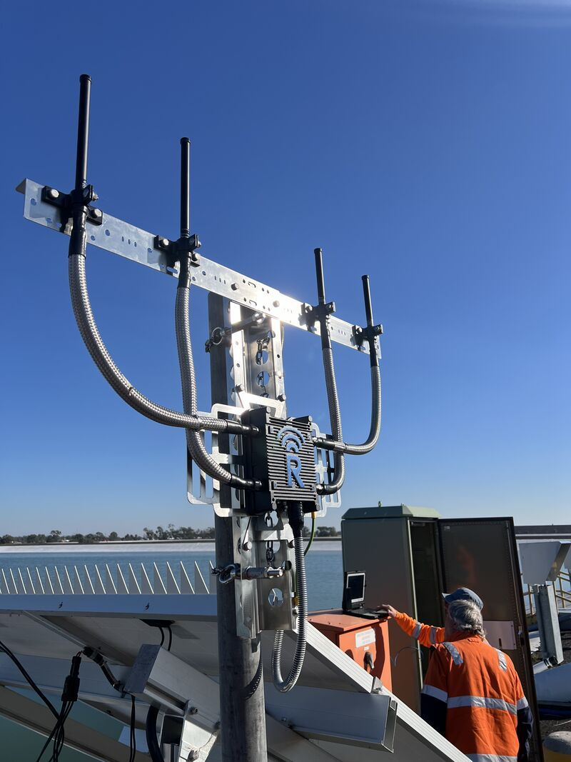
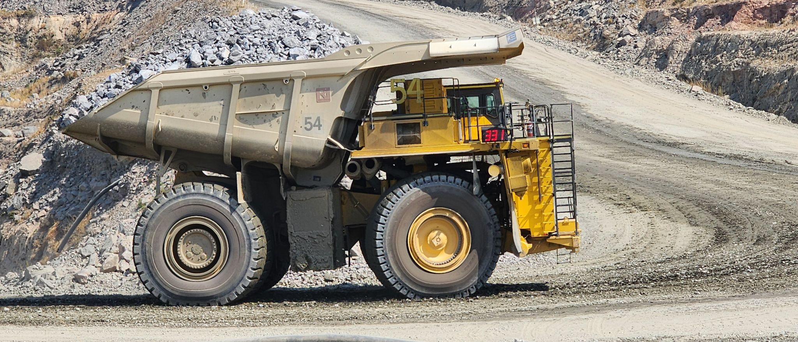
Example Usage
3

Slide 4
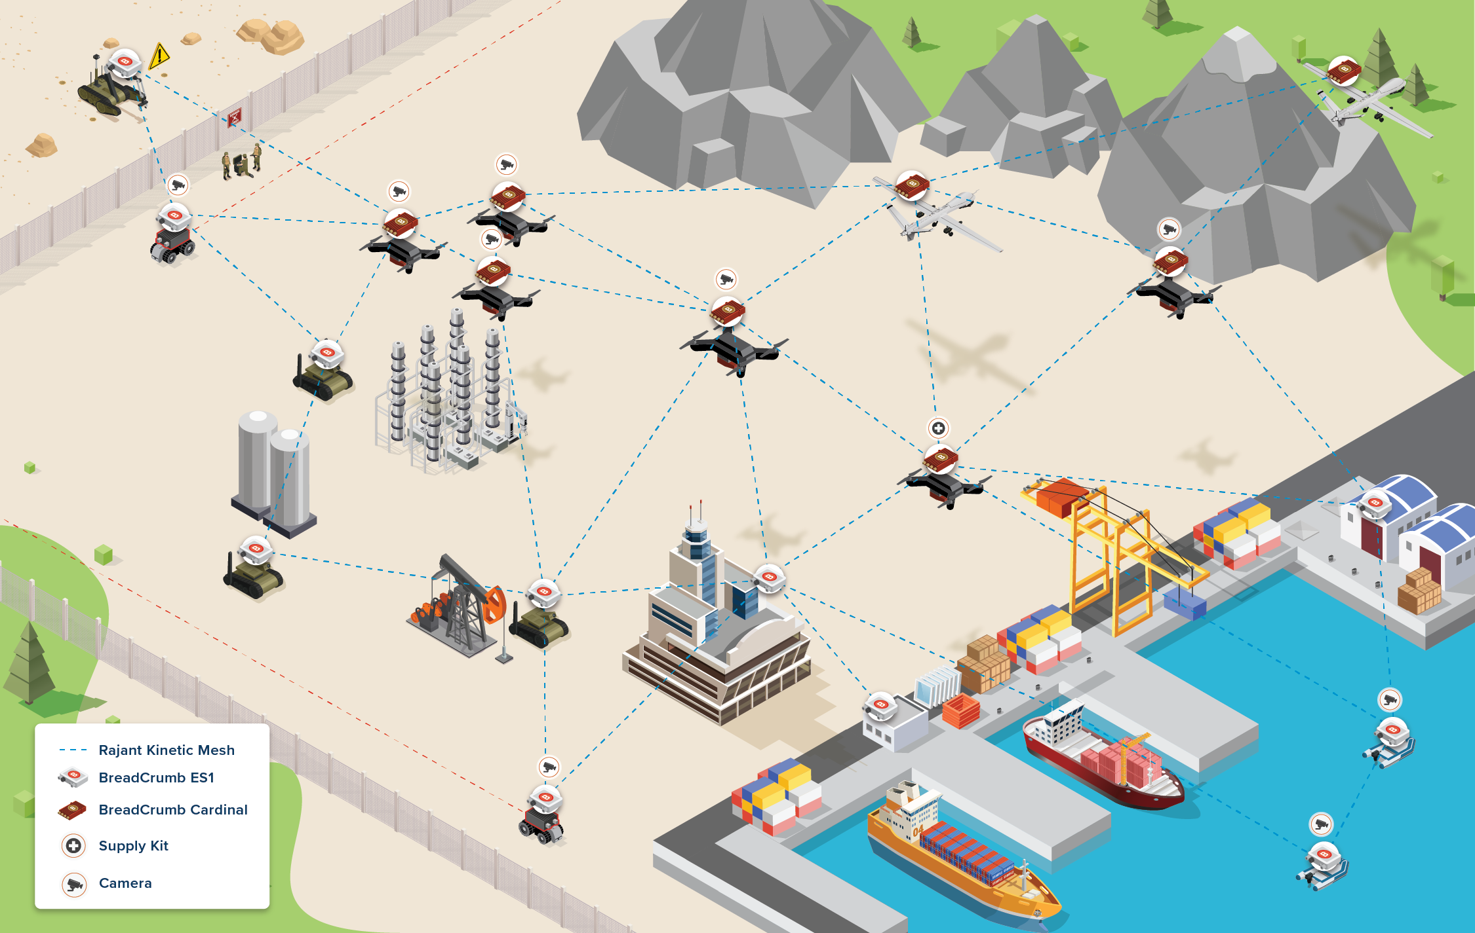
Scenario
4

Slide 5
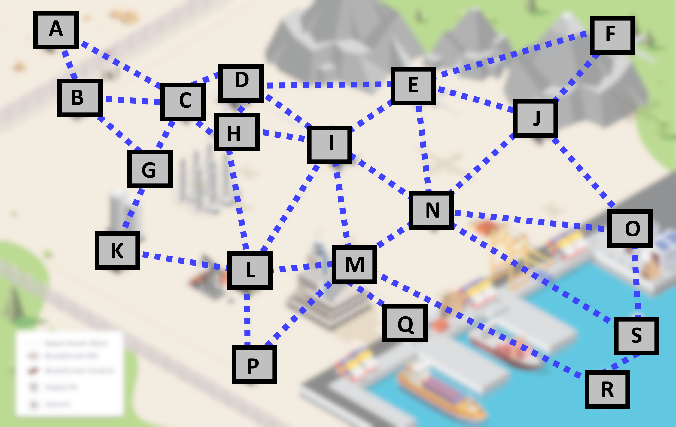
Scenario
5

Slide 6
Log Files
# instamesh routing table
Dest cost next hop next hop cost
---- ---- -------- -------------
A 4 I 1
B 4 I 1
C 3 I 1
D 2 I 1
E 2 I 1
F 3 I 1
G 3 L 1
H 2 I 1
I 1 I 1
J 2 N 1
K 2 L 1
L 1 L 1
N 1 N 1
O 2 N 1
P 1 P 1
Q 1 Q 1
R 1 R 1
S 2 N 1
# breadcrumb serial number
M
# instamesh neighbors
neighbor cost
-------- ----
I 1
L 1
N 1
P 1
Q 1
R 1
6

Slide 7
Scenario
# instamesh routing table
Dest cost next hop next hop cost
---- ---- -------- -------------
A 4 I 1
7

Slide 8
Log Files
# instamesh routing table
Dest cost next hop next hop cost
---- ---- -------- -------------
A 4 I 1
B 4 I 1
C 3 I 1
D 2 I 1
E 2 I 1
F 3 I 1
G 3 L 1
H 2 I 1
I 1 I 1
J 2 N 1
K 2 L 1
L 1 L 1
N 1 N 1
O 2 N 1
P 1 P 1
Q 1 Q 1
R 1 R 1
S 2 N 1
# breadcrumb serial number
M
# instamesh neighbors
neighbor cost
-------- ----
I 1
L 1
N 1
P 1
Q 1
R 1
My job is to make software that generates useful reports from all this stuff.
8

Slide 9
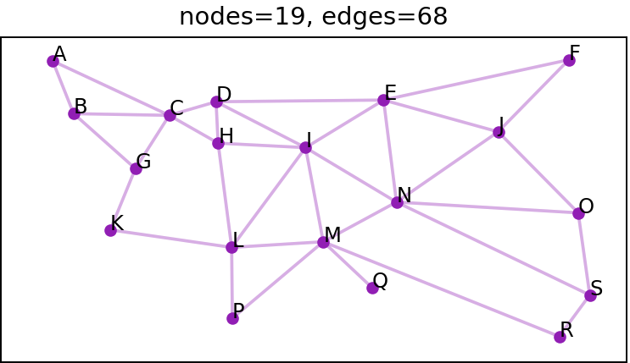
Scenario
9

Slide 10
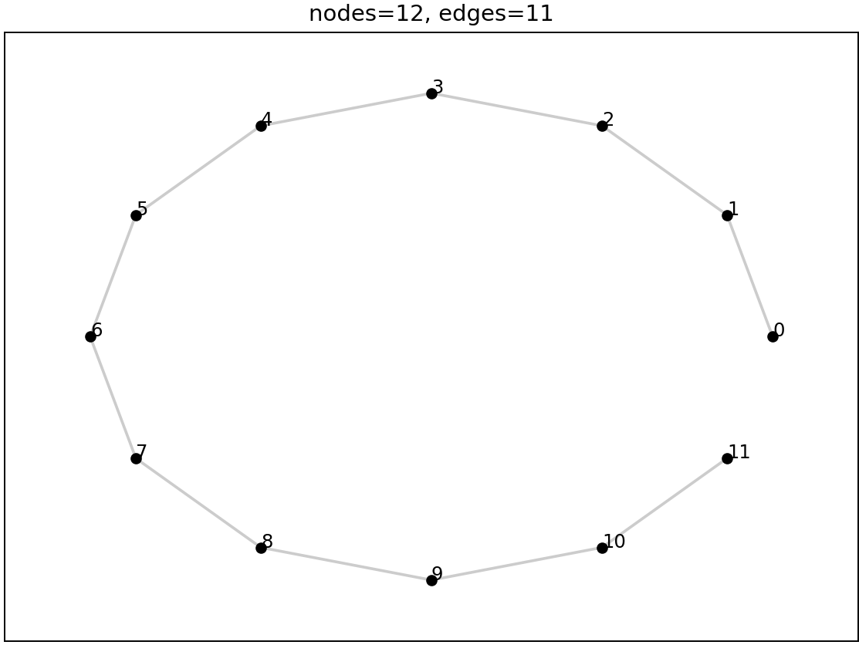
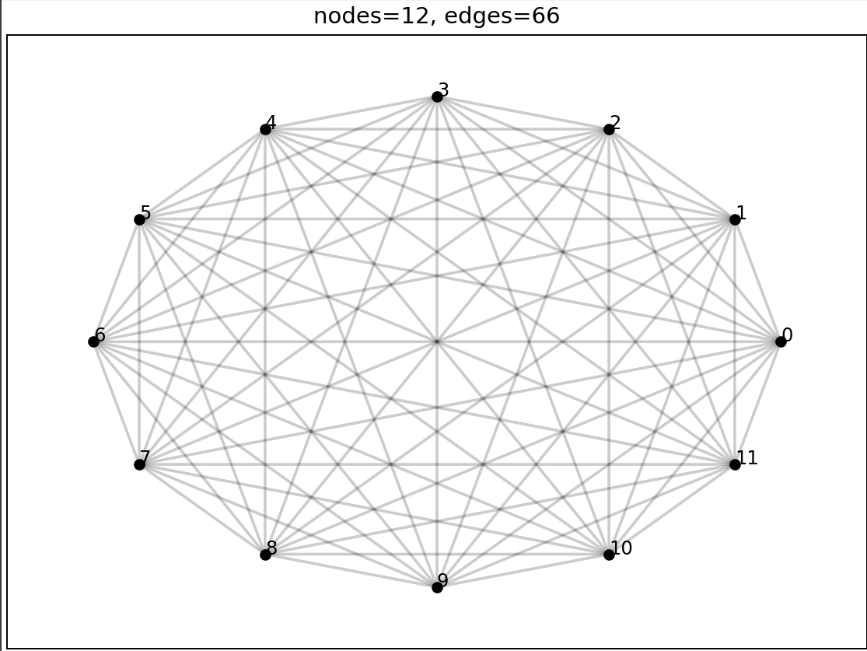

How many edges?
$$max=\frac{n^{2}−n}{2}=O(n^{2})$$
$$min=n−1=O(n)$$
10

Slide 11
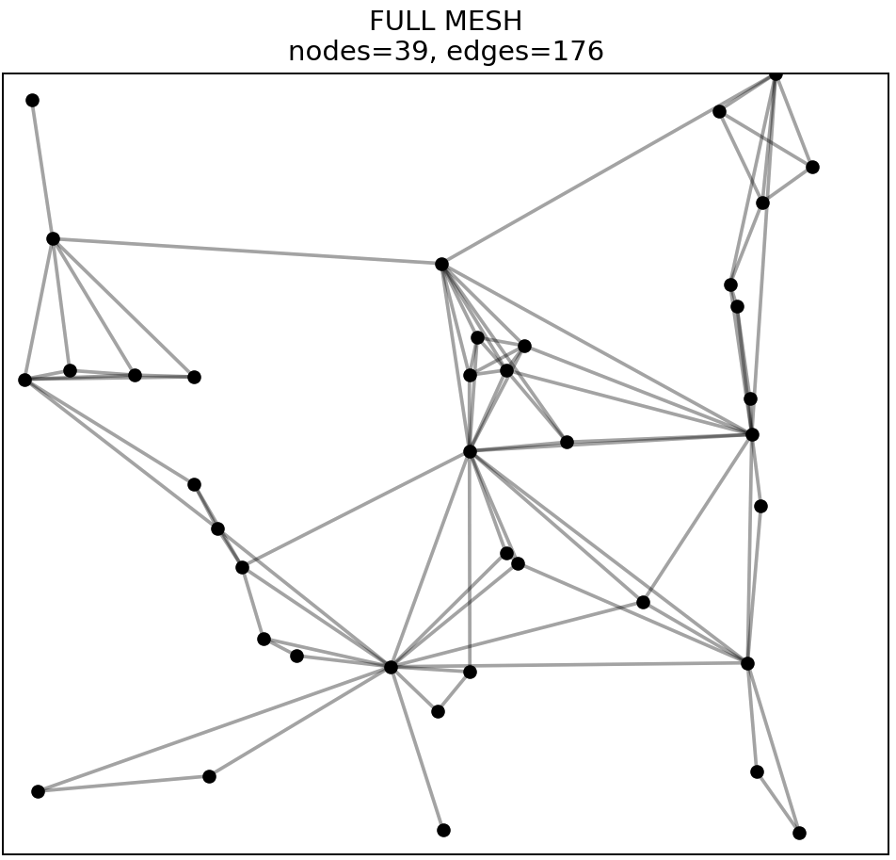
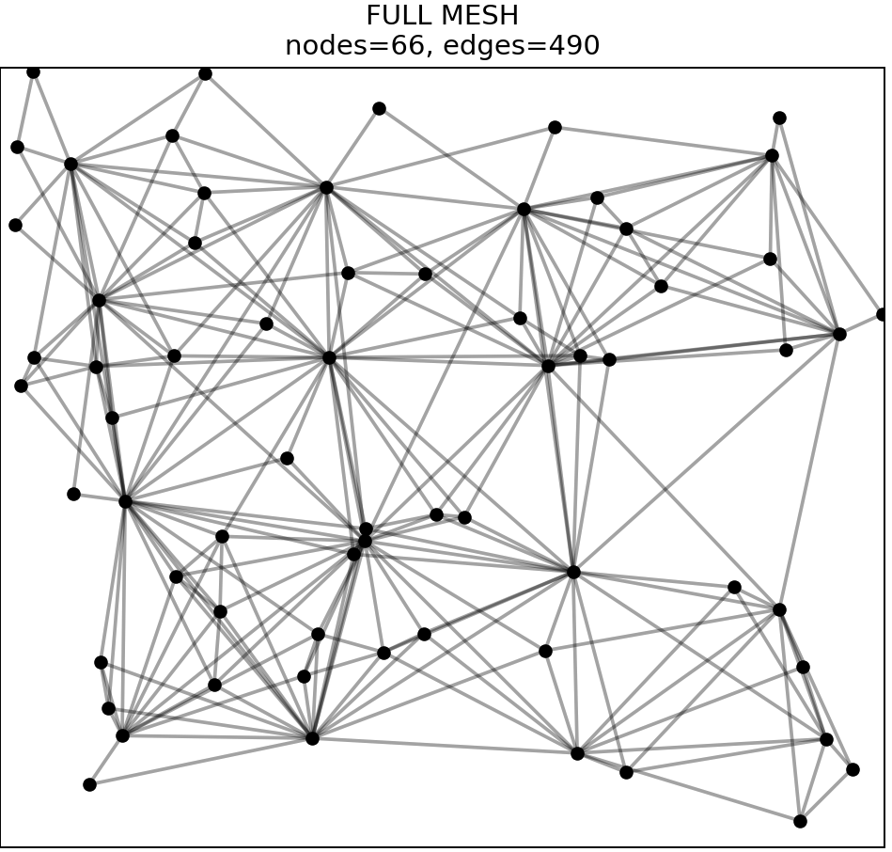
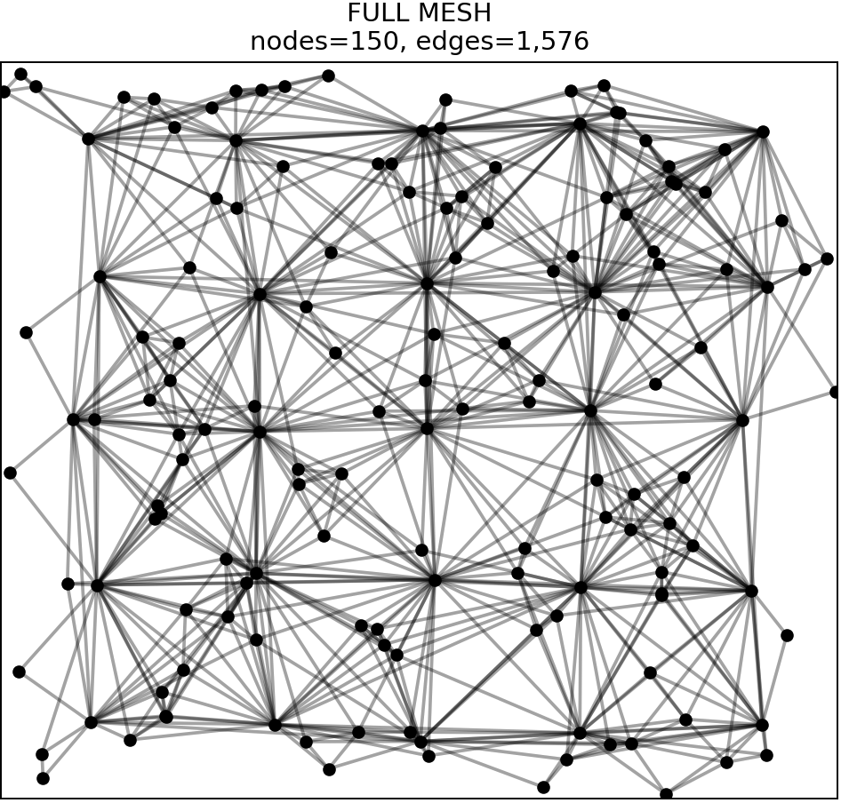
Example meshes
Rajant meshes are usually pretty dense.
11

Slide 12
So what?
Things we can do with our graph representation:
Find the longest routing path
Find the vertex that is used the most commonly in routing
Find the edge that is used the most commonly in routing
Find nodes that would cause the network to be split if they failed.
12

Slide 13
Longest routing path
Problem: What is the longest active path?
Strategy:
Find all pairs of nodes (start, finish)
How many pairs?
O(n^2)
Find length of each route
How long does this take?
O(n) in worst case, O(1) in most practical cases.
Overall running time:
O(n^2) pairs, each pair takes O(1), so O(n^2 * 1) = O(n^2)
13

Slide 14
Longest routing path
source='A' dest='O'
longest_path=
[
InstameshRoutingTableEntry(next_hop_node='C'),
InstameshRoutingTableEntry(next_hop_node='D'),
InstameshRoutingTableEntry(next_hop_node='E'),
InstameshRoutingTableEntry(next_hop_node='J'),
InstameshRoutingTableEntry(next_hop_node='O')
]
14

Slide 15
Most common vertex
Problem: Which vertex is used most often in routes?
Strategy:
Find all pairs of nodes (start, finish)
How many pairs?
O(n^2)
Traverse each route and add 1 for each vertex we find
How long does this take?
O(n) in worst case, O(1) in most practical cases.
Overall running time:
O(n^2) pairs, each pair takes O(1), so O(n^2 * 1) = O(n^2)
15

Slide 16
Most common vertex
waypoints.most_common()=
[
('D', 80),
('E', 78),
('C', 76),
('I', 76),
('M', 70),
('N', 52),
('L', 48),
('H', 16),
('J', 14),
('K', 10),
('G', 8),
('B', 4),
('S', 2),
]
16

Slide 17
Most common edge
Problem: Which edge is used most often in routes?
Strategy:
Find all pairs of nodes (start, finish)
How many pairs?
O(n^2)
Traverse each route and add 1 for each (vertex1, vertex2) pair we find
How long does this take?
O(n) in worst case, O(1) in most practical cases.
Overall running time:
O(n^2) pairs, each pair takes O(1), so O(n^2 * 1) = O(n^2)
17

Slide 18
Most common edge
waypoints.most_common()=
[
(('C', 'D'), 42),
(('D', 'C'), 42),
(('D', 'E'), 33),
(('E', 'D'), 33),
(('I', 'M'), 24),
(('M', 'I'), 24),
(('M', 'Q'), 18),
(('L', 'K'), 18),
(('K', 'L'), 18),
(('Q', 'M'), 18),
(('D', 'I'), 17),
(('E', 'I'), 17),
(('I', 'L'), 17),
(('I', 'D'), 17),
(('I', 'E'), 17),
(('L', 'I'), 17),
# Plus a bunch more
]
18

Slide 19
Critical Nodes
Problem: What nodes will cause a disconnection if they fail?
Example: If node M fails, node Q will have no connection to the rest of the mesh, so we say that M is a critical node. (“Articulation Point” is the fancy term in graph theory.)
Are there other critical nodes?
Strategy:
???
19

Slide 20
Connected Components
In a graph, a “connected component” is a chunk where all vertices have a path to all other vertices in the chunk.
Connected components algorithm:
Make a list “remaining” of all vertices.
Pick first vertex from list.
Run depth-first search on graph. Remove each vertex from “remaining” as you visit it.
Repeat until “remaining” is empty. The number of loop iterations is the number of connected components.
Running time is just running time of depth-first search, which is O(V+E)
20

Slide 21
Critical Nodes-naïve strategy
Strategy:
Remove vertex V
Run a “connected components” algorithm to see if there are more connected components afterwards than before.
If yes, then V is a critical node. If no, then V is not a critical node.
Add vertex V back to the graph
Repeat for all vertices
Running time?
Connected components algorithm is O(V+E), which = O(V^2) for dense meshes.
Have to run it V times, so run time is O(V^2 * V) = O(V^3)
21

Slide 22
Critical Nodes-fancy strat
Strategy:
Google “critical points in network graph”
Find a StackOverflow post that says “These are called ‘Articulation Points.’”
Google “Articulation Points”
Find “Tarjan’s Algorithm” Wikipedia page
Read it. Get confused. But learn that it’s based on DFS and takes O(V+E) time (same as DFS).
Ask GitHub Copilot to write a function that does it.
It works!
Time complexity: O(V+E) = O(V^2) for dense meshes.
Money complexity: O($10/month) for GitHub Copilot
22

Slide 23
Critical Nodes-the code
# Entirely generated by GitHub Copilot. def find_articulation_points(graph: Graph) -> set[Node]:
def dfs_articulation(node: Node, parent: Node, visited: set[Node],
discovery: dict[Node, int], low: dict[Node, int], time: int,
articulation_points: set[Node],
):
visited.add(node)
discovery[node] = low[node] = time
children = 0 for neighbor in node.neighbors:
if neighbor == parent:
continue
if neighbor not in visited:
children += 1
dfs_articulation(neighbor, node, visited, discovery, low, time + 1,articulation_points)
low[node] = min(low[node], low[neighbor]) if parent is None and children > 1:
articulation_points.add(node)
if parent is not None and low[neighbor] >= discovery[node]:
articulation_points.add(node)
else:
low[node] = min(low[node], discovery[neighbor]) visited = set()
discovery = {}
low = {}
articulation_points = set() for node in graph.nodes:
if node not in visited:
dfs_articulation(node, None, visited, discovery, low, 0, articulation_points) return articulation_points
23

Slide 24

And now for something completely different!
24

Slide 25
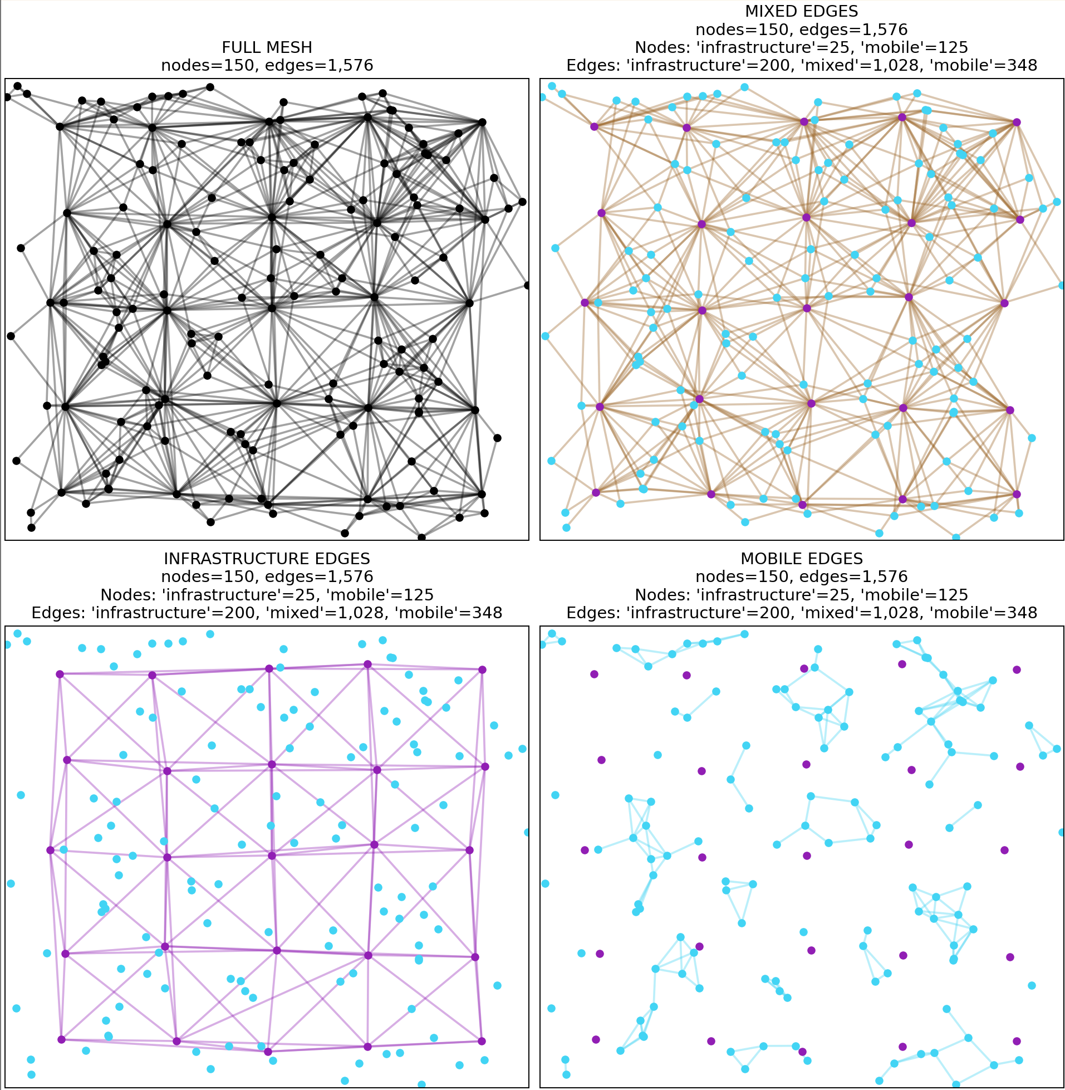
Node types
Most of our meshes have permanent/infrastructure nodes (breadcrumbs mounted on poles) and temporary/mobile ones (breadcrumbs mounted on vehicles).
We care about the infrastructure ones a lot more.
25

Slide 26
Node types
What we get from the logs is the upper left graph.
How can we separate out the infrastructure (lower left) from mobile (lower right) nodes?
If you can think of a good answer, email me your resume.
26

Slide 27

(Horrible) code and this presentation available at github.com/davidmayo/acm-presentation David Mayo Rajant Corporation, Morehead, KY
dmayo@rajant.com
Notes:
Any Questions?

